Slide 1
Module 2: Mechanical Separations (Chapter 29)
Lecture 3
Somak Chatterjee

Slide 2
Pressure drop through filter cake

Slide 3
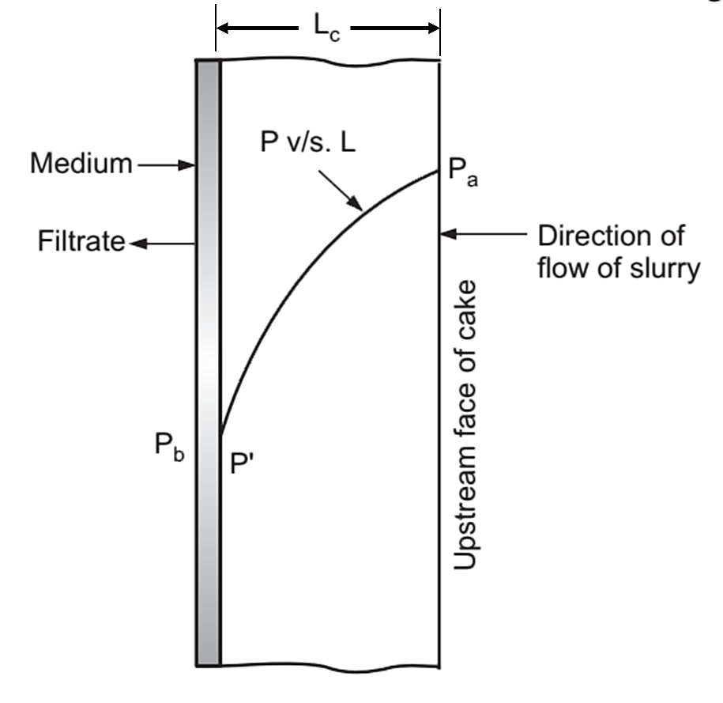
PRESSURE DROP THROUGH FILTER CAKE

Slide 4
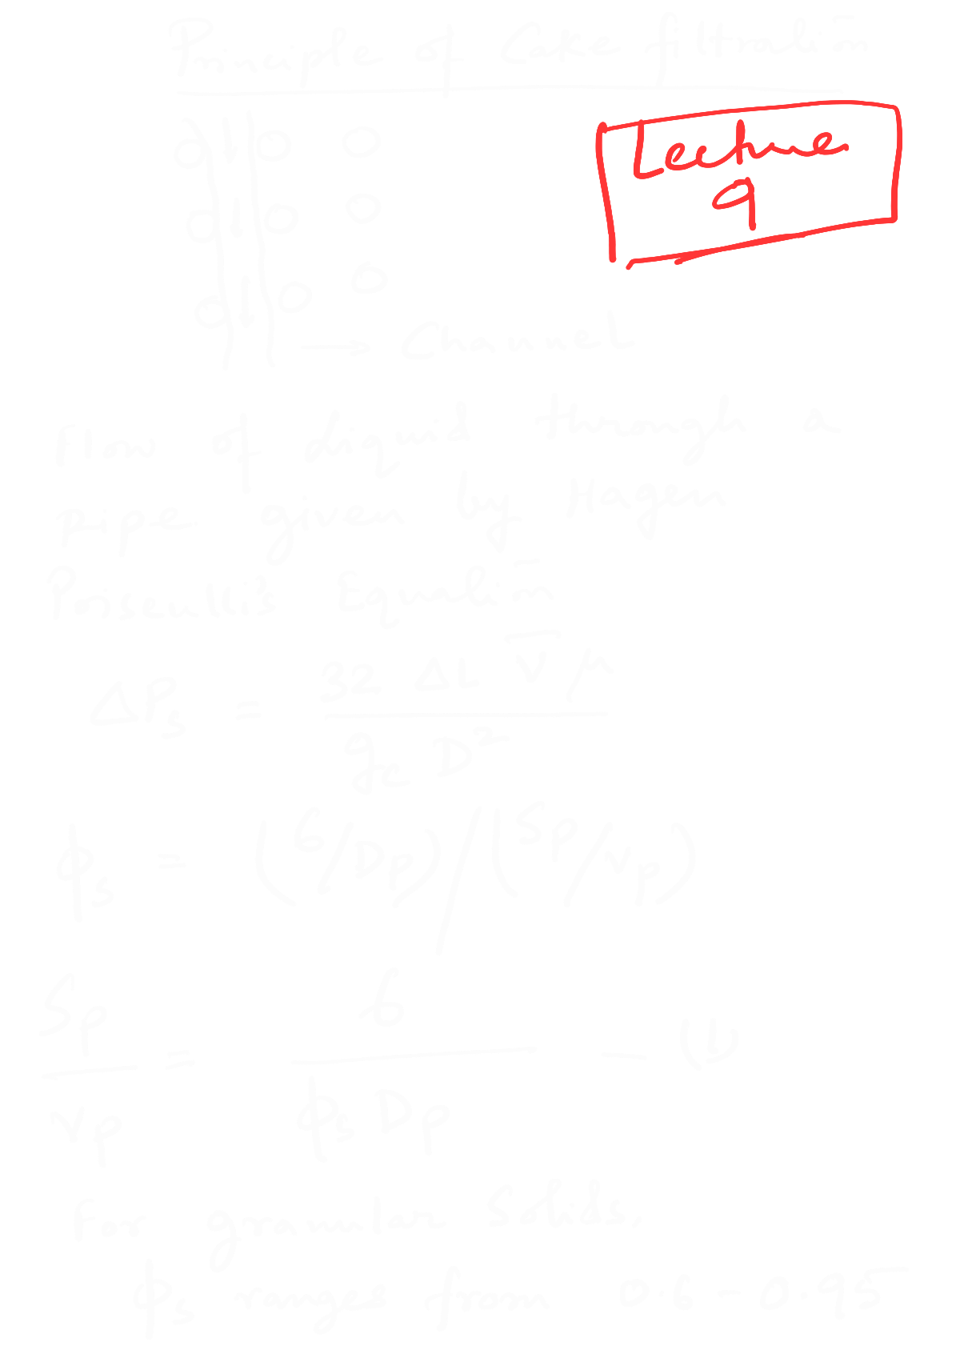


Slide 5


Slide 6


Slide 7


Slide 8


Slide 9


Slide 10


Slide 11


Slide 12


Slide 13
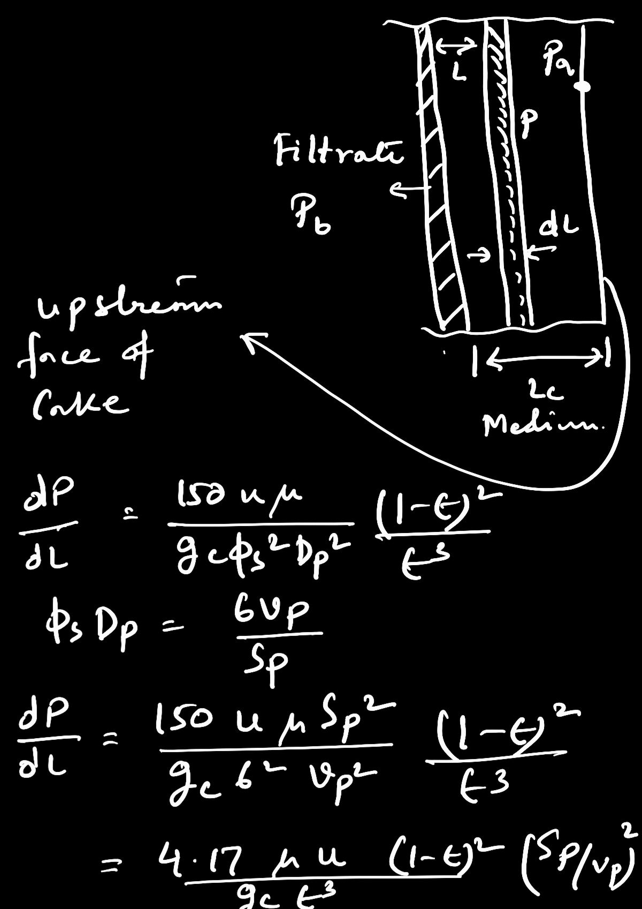

Slide 14


Slide 15


Slide 16


Slide 17
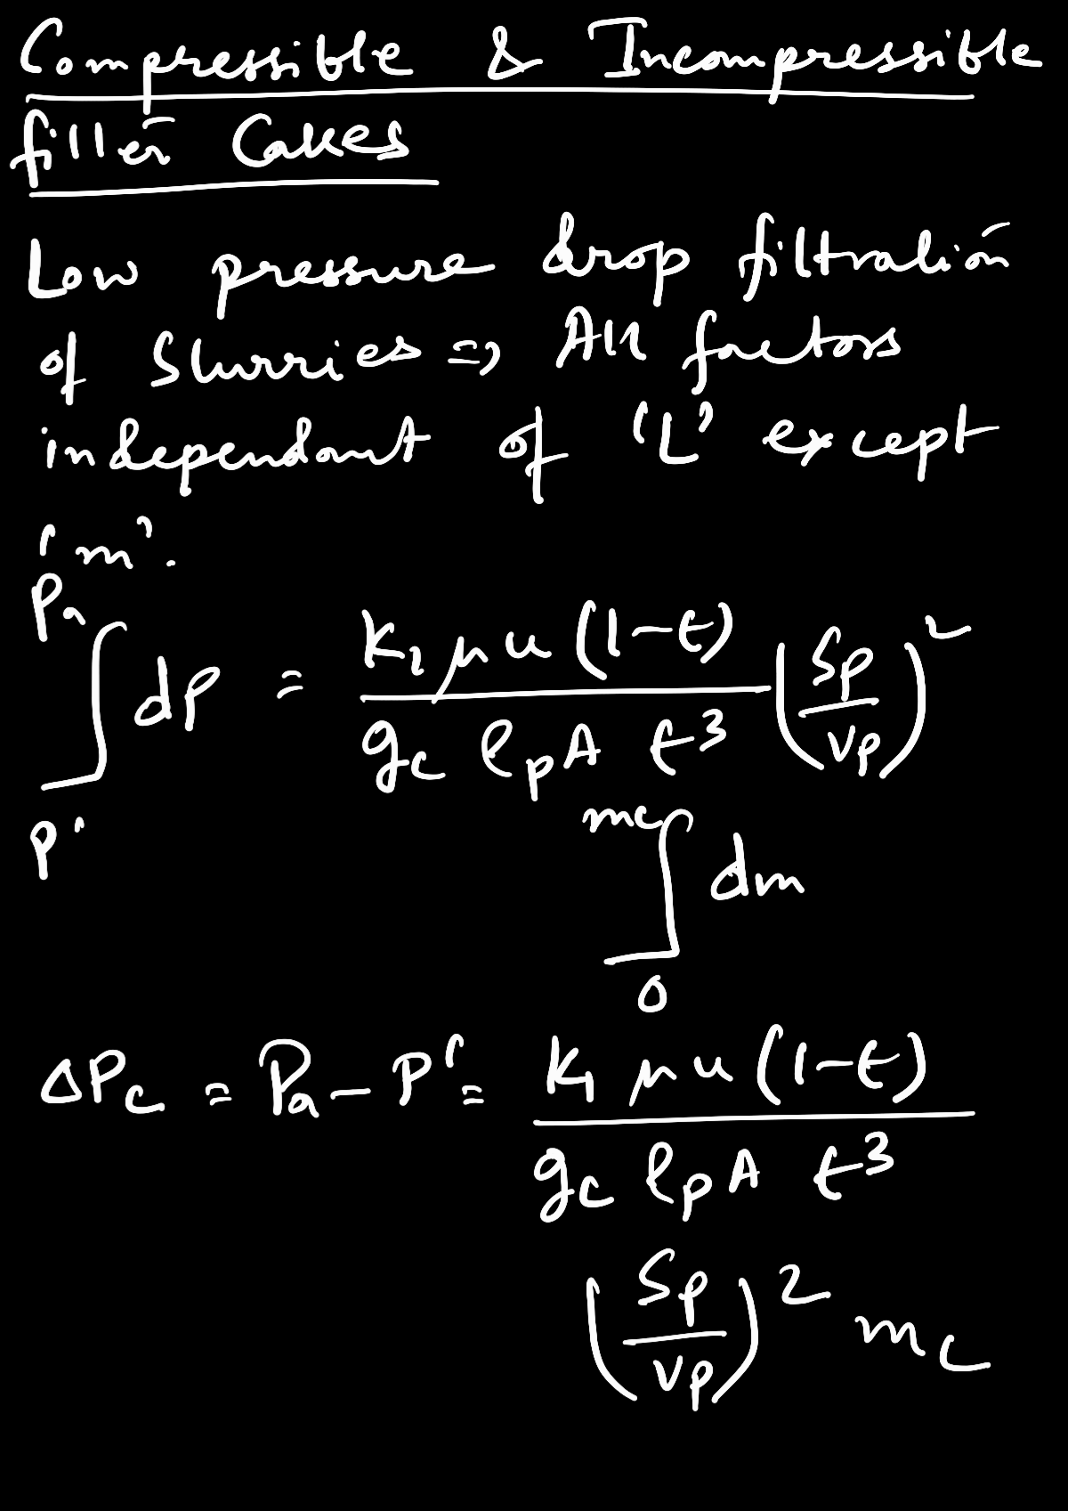

Slide 18


Slide 19


Slide 20
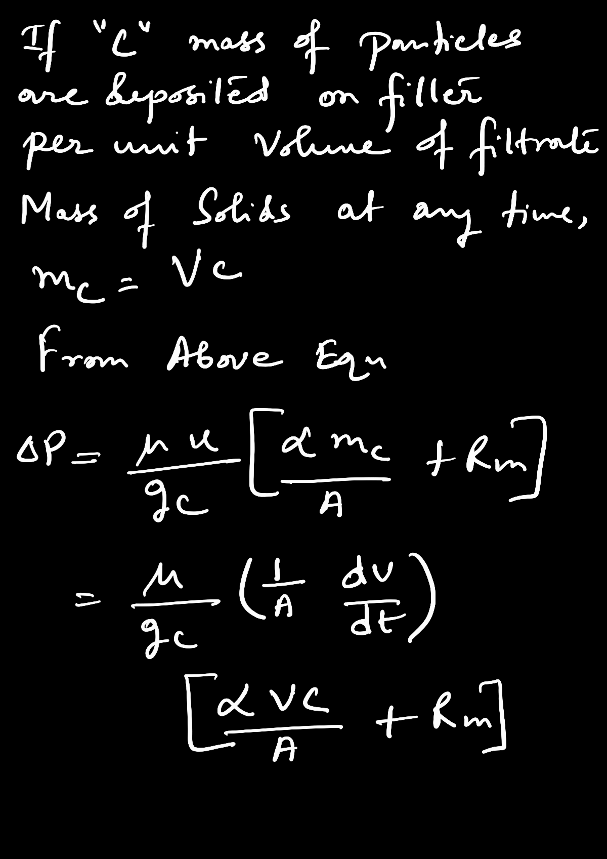

Slide 21


Slide 22


Slide 23
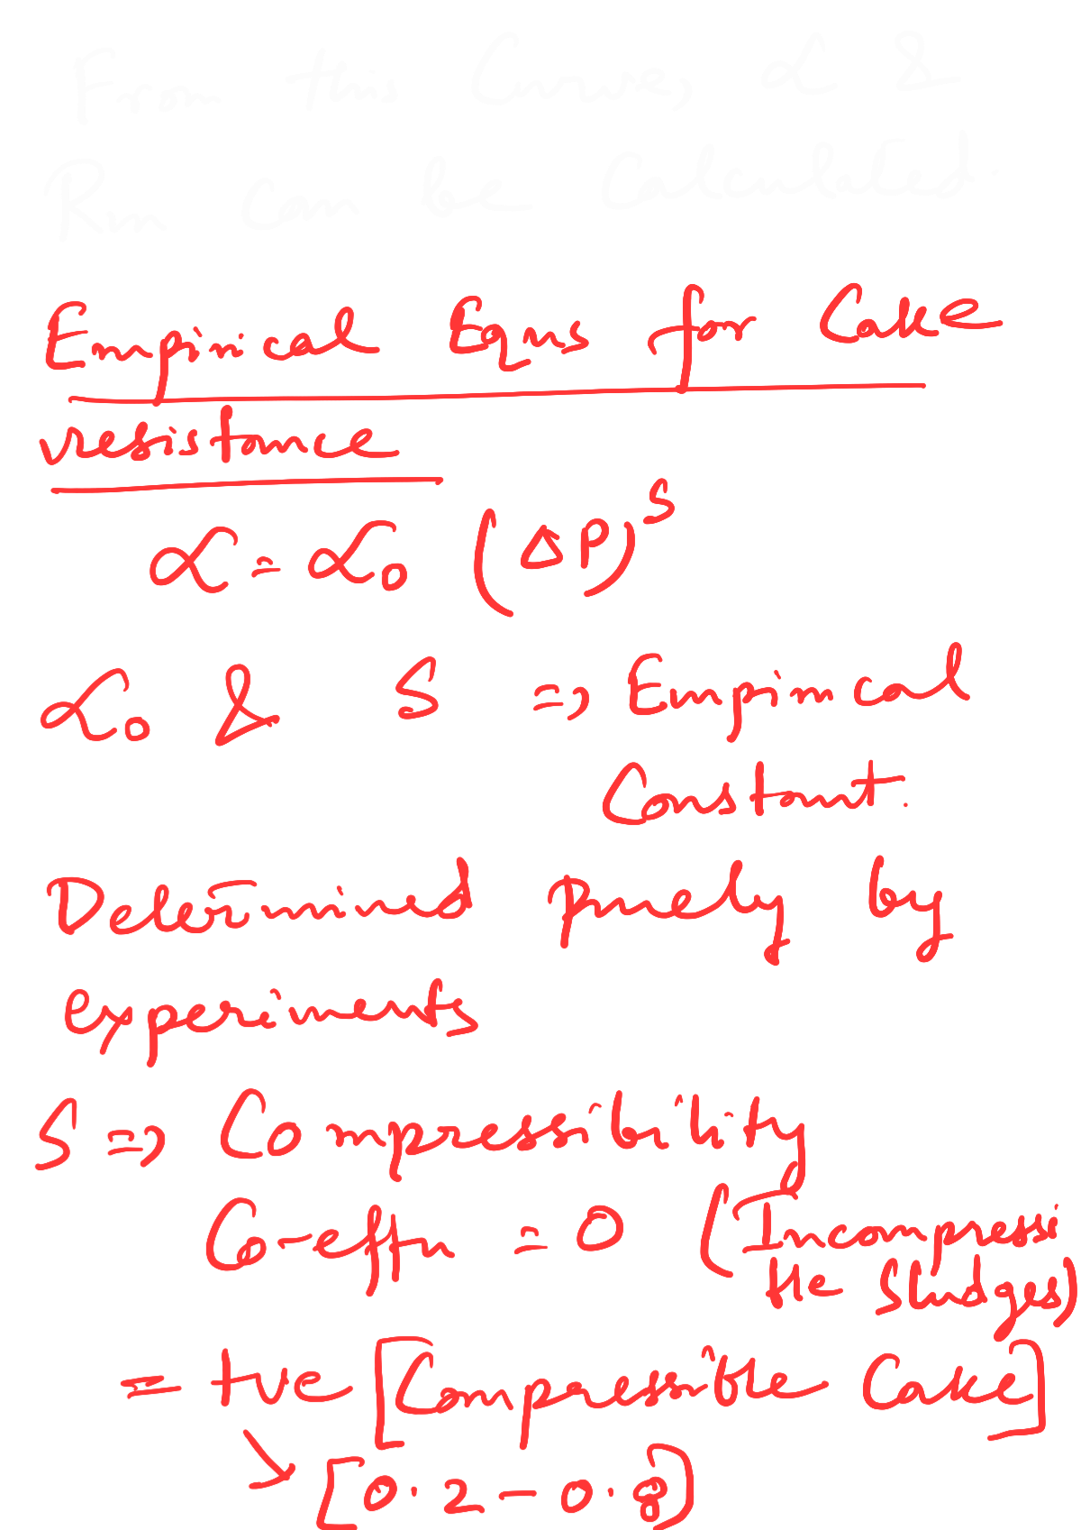

Slide 24
Different filtrations
Constant-pressure filtration
Continuous filtration
Constant rate filtration

Slide 25
References
Smith, J., Harriott, P., McCabe, W. (2005). Unit Operations of Chemical Engineering. Colombia: McGraw-Hill Education.
Swain, A. K., Patra, H., & Roy, G. K. (2011). Mechanical operations. Tata McGraw Hill.

